Slide 1
Distributive Property
Examples
Big Ideas and Vocabulary
Factored Form | Expanded Form
3(2x + 4y)
5(y + 8)
 | 12y + 15x
 | 24 + 32b

Slide 2
Finding the Percent When You Know the Part and the Whole (Total)
Examples
A soccer team played 20 total games. They won won 15 games. What percent of their games did they win? Un equipo de fútbol jugó 20 partidos en total. Ganaron, ganaron 15 juegos. ¿Qué porcentaje de sus juegos ganaron? The team won ____________ % of their games this season.
Big Ideas and Vocabulary

Slide 3
Division Using the Standard Algorithm
Examples
6 people are equally splitting a bill that is $87. How much money will each person pay?
Big Ideas and Vocabulary

Slide 4
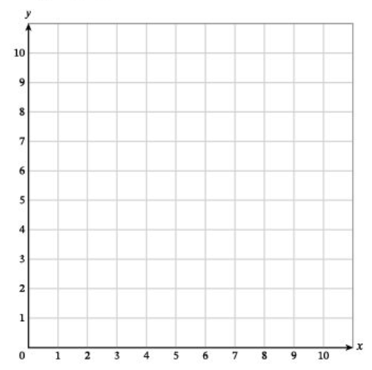
Coordinate Plane
Examples
Big Ideas and Vocabulary
A
B
Point | Ordered Pair
A
B
C | (3, 5)
D | (8, 0)

Slide 5
Writing and Graphing Inequalities
Examples
Big Ideas and Vocabulary
You have less than 5 pencils.
You have at least $10.
The test has no more than 20 problems.
Your break is no more than 8 minutes.

